Slide 1

Q4E, Maven integration for Eclipse
Carlos Sanchez
March 19, 2008

Slide 2
About me
During the day
Director at Exist Global
At night
Member of Apache Maven PMC
Committer at the Eclipse Foundation

Slide 3
Maven in the IDE
Q4E
[Q for Eclipse]
http://code.google.com/p/q4e

Slide 4
Maven in the IDE
Proposed to the Eclipse Foundation as
Eclipse IAM
[Eclipse Integration for Apache Maven]
http://www.eclipse.org/proposals/iam

Slide 5
Q4E Features
running Maven goals from the IDE
dependency managing using the POM
& automatic download of dependencies
Eclipse classpath synchronized with POM

Slide 6
Q4E Features
direct import of Maven 2 projects
wizard for creation of new projects using the archetype mechanism
WTP support (from today!)‏

Slide 7
Q4E Features
modular approach to improve reusability by other Eclipse projects
ability to import parent projects (pom projects)‏
ability to cancel Maven builds

Slide 8
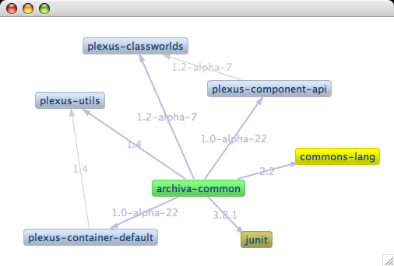
Q4E dependency graphing

Slide 9
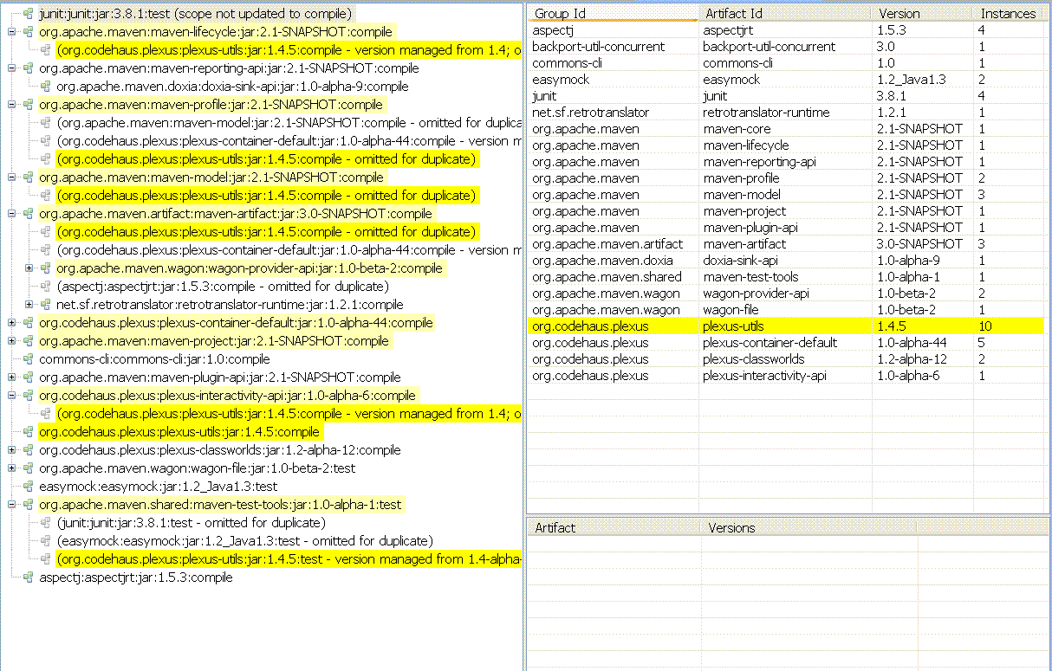
Q4E dependency analysis

Slide 10
Roadmap
Integration with other plugins
Scala, Candy for Appfuse, SpringIDE,...
UI tooling to work around Maven
limitations (common complains)‏
Excluding a dependency from the graphs will add all necessary <exclusions> to the pom

Slide 11
Thanks
carlos@apache.org
http://www.carlossanchez.eu

